Slide 1
JavaScript Events

Slide 2
Event
An event is a signal that something has happened
All DOM nodes generate such signals

Slide 3
Mouse events:
Event Performed | Event Handler | Description
click | onclick | When mouse click on an element
mouseover | onmouseover | When the cursor of the mouse comes over the element
mouseout | onmouseout | When the cursor of the mouse leaves an element
mousedown | onmousedown | When the mouse button is pressed over the element
mouseup | onmouseup | When the mouse button is released over the element
mousemove | onmousemove | When the mouse movement takes place.

Slide 4
Keyboard events:
Event Performed | Event Handler | Description
Keydown & Keyup | onkeydown & onkeyup | When the user press and then release the key

Slide 5
Form events:
Event Performed | Event Handler | Description
focus | onfocus | When the user focuses on an element
submit | onsubmit | When the user submits the form
blur | onblur | When the focus is away from a form element
change | onchange | When the user modifies or changes the value of a form element

Slide 6
Window/Document events
Event Performed | Event Handler | Description
load | onload | When the browser finishes the loading of the page
unload | onunload | When the visitor leaves the current webpage, the browser unloads it
resize | onresize | When the visitor resizes the window of the browser

Slide 7
Click Event
<script language="Javascript" type="text/Javascript">
<!--
function clickevent()
{
document.write("This is Cranberrys");
}
//-->
</script>
<form>
<input type="button" onclick="clickevent()" value="Who's this?"/>
</form>

Slide 8
<!-- //-->
Used to perform action once

Slide 9
Click Event
<script>
function showAlert()
{
alert('Clicked!');
}
</script>
<input type="button" value="Save" onclick="showAlert()">

Slide 10
Example
<script>
function countRabbits() {
for(let i=1; i<=3; i++) {
alert("Rabbit number " + i);
}
}
</script>
<input type="button" onclick="countRabbits()" value="Count rabbits!">

Slide 11
MouseOver Event
<script language="Javascript" type="text/Javascript">
<!--
function mouseoverevent()
{
alert("This is JavaTpoint");
}
//-->
</script>
<p onmouseover="mouseoverevent()"> Keep cursor over me</p>

Slide 12
Focus Event
<body>
<h2> Enter something here</h2>
<input type="text" id="input1" onfocus="focusevent()"/>
<script language="Javascript" type="text/Javascript">
<!--
function focusevent()
{
document.getElementById("input1").style.background=" aqua";
}
//-->
</script>

Slide 13
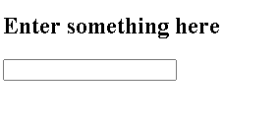
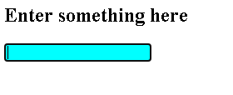
Output

Slide 14
Keydown Event
<body>
<h2> Enter something here</h2>
<input type="text" id="input1" onkeydown="keydownevent()"/>
<script>
<!--
function keydownevent()
{
document.getElementById("input1");
alert("Pressed a key");
}
//-->
</script>
</body>

Slide 15
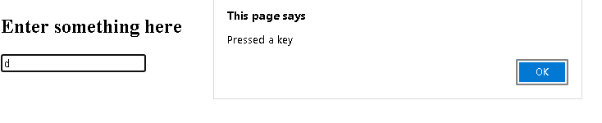
Output

Slide 16
Load event
<body onload="window.alert('Page successfully loaded');">
<script>
<!--
document.write("The page is loaded successfully");
//-->
</script>
</body>

